Slide 1
Lecture 2: sampling, filters, convolution, digital formats
luke@sjulsonlab.org

Slide 2
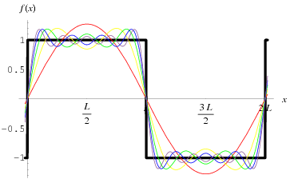
Signals can be decomposed into sinusoids

Slide 3
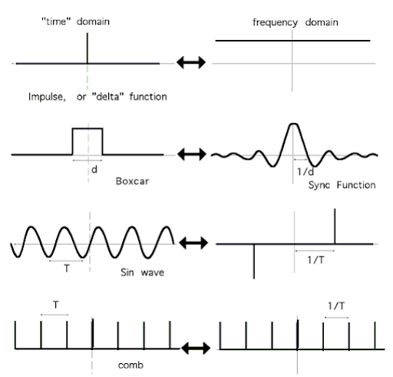
The Fourier transform converts from time to frequency domain
Sometimes called
Dirac delta function, δ(t)
Note that the delta function contains all frequencies
T = wavelength
1/T = frequency

Slide 4
Filters and transfer functions
Filters (mostly) block certain frequencies and let others pass through
Draw transfer functions by hand…

Slide 5
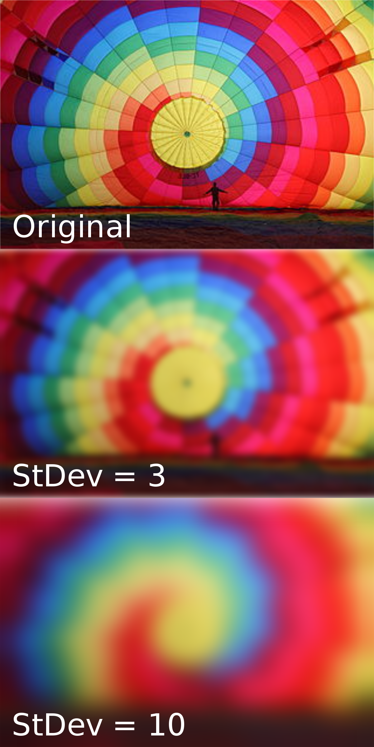
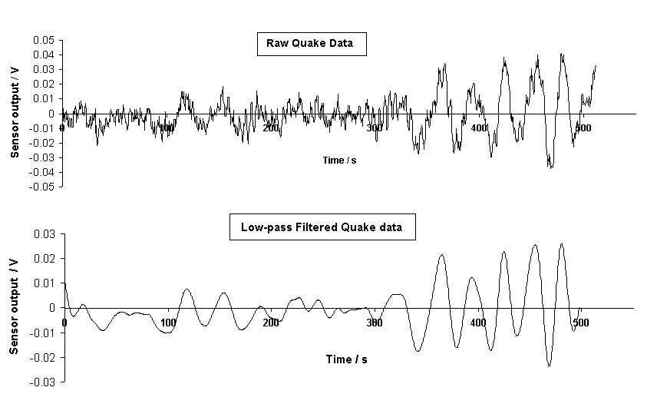
Filtering examples
Draw example of high-pass filtering

Slide 6
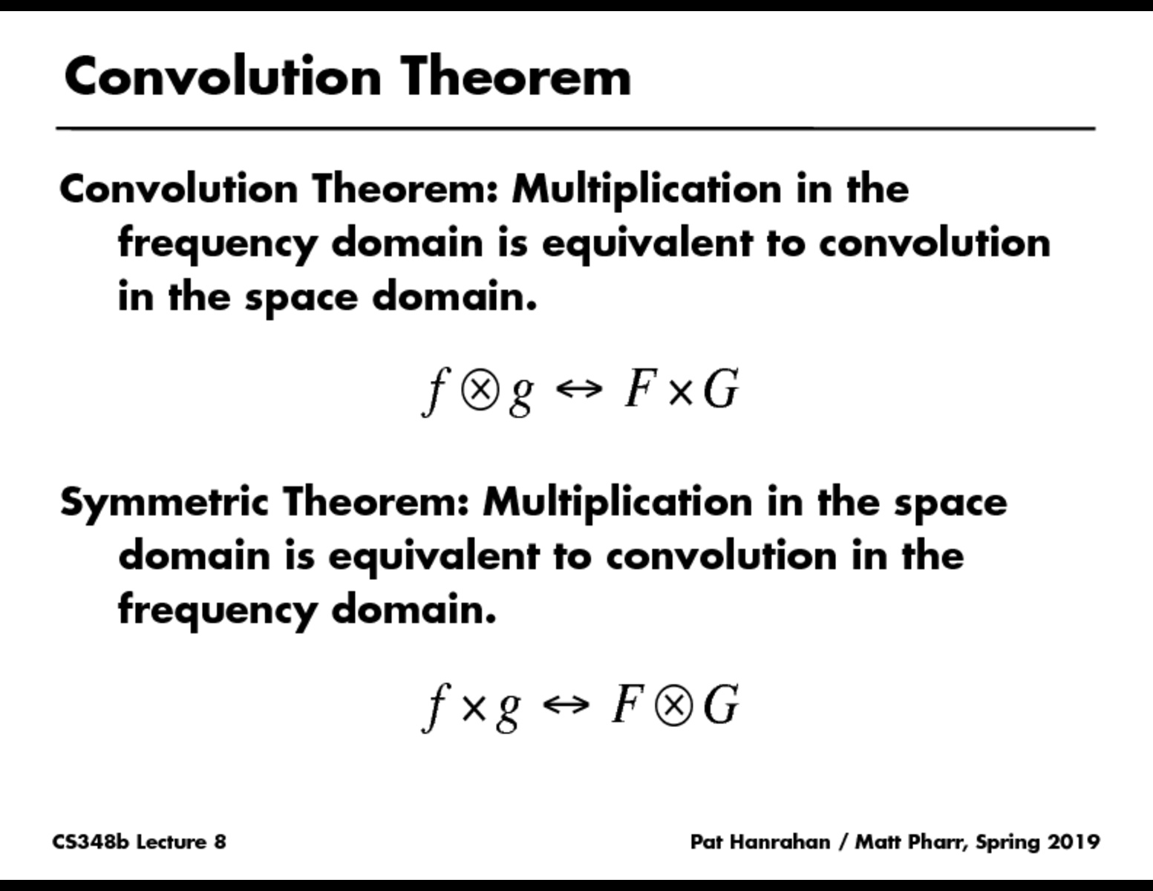
Convolution: the time domain version of filtering
time
time

Slide 7
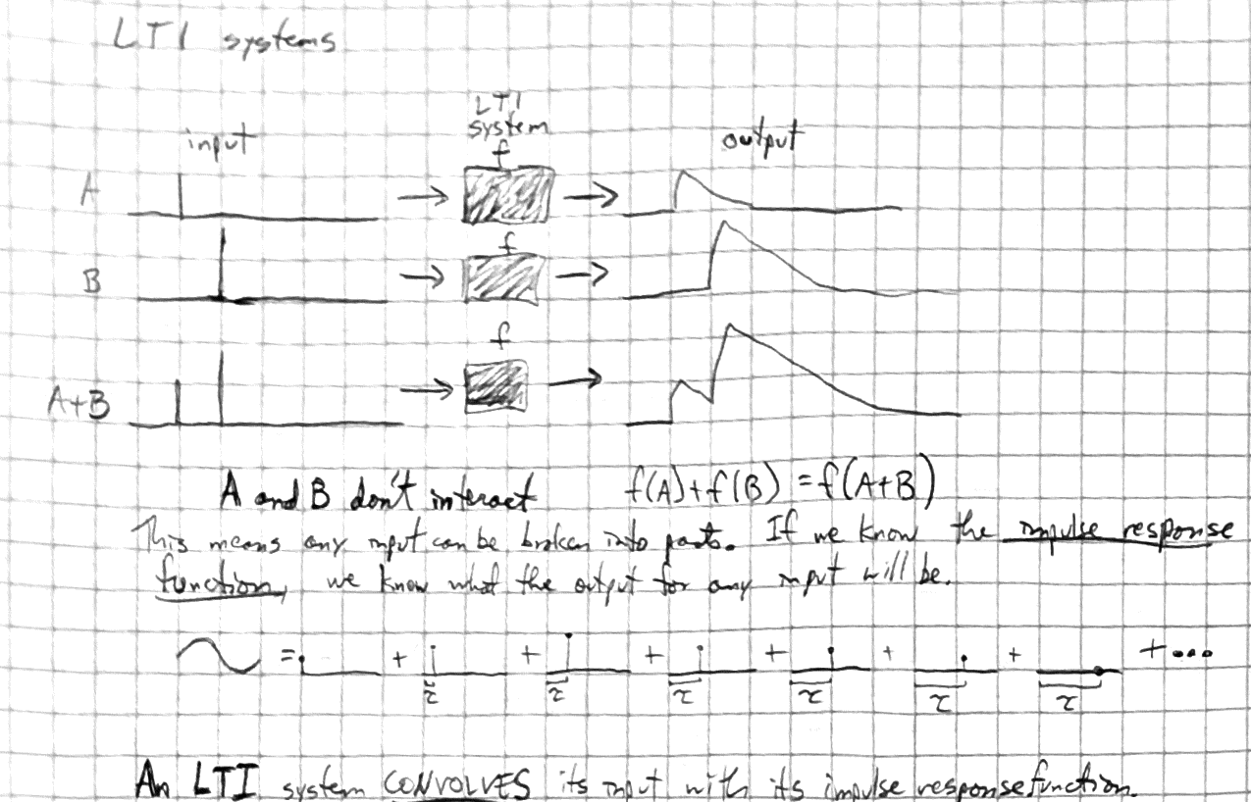
The output of Linear Time Invariant (LTI) systems is the convolution of the input with the impulse response function

Slide 8
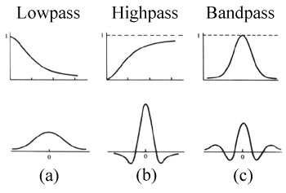
Filter transfer functions (freq domain) are Fourier transforms of their convolution kernels (time domain)
Frequency
Frequency
Frequency
Time
Time
Time

Slide 9
Harmonics and notch filters
Draw by hand

Slide 10
Filtering: important points
Filtering removes certain frequencies
Multiplication in the frequency domain (e.g. filtering) equals convolution in the time domain and vice versa
Filtering (in freq domain) corresponds to convolution (in time domain) with a filter “kernel”
Conversely, convolution (time domain) can be conceptualized as filtering (freq domain)
Distortions of an underlying signal by instrumentation, ChR2, or GCaMP are convolutions*
ChR2 and GCaMP act as low-pass filters
* if they are operating in a linear range – see lecture 5

Slide 11
Sampling
How do you configure your filter settings and sampling rate correctly?

Slide 12
Good Sampling
Sampling rate = 8X frequency

Slide 13
Bad sampling
Sampling rate = 1.5x frequency

Slide 14
Still bad
Sampling rate = 2X frequency
Nyquist’s theorem: to capture a frequency accurately, you must sample more than 2X that frequency

Slide 15
Adequate sampling
Sampling rate = 3X frequency

Slide 16
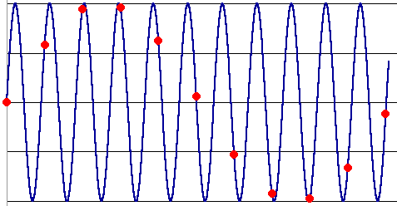
Why is undersampling bad? Aliasing
The blue is the true underlying signal
The red dots are the samples, taken at too low of a sampling rate
This “aliases” the blue signal, which has a frequency more than 2X the sampling rate, into an artifactual signal with a frequency less than 2X the sampling rate

Slide 17
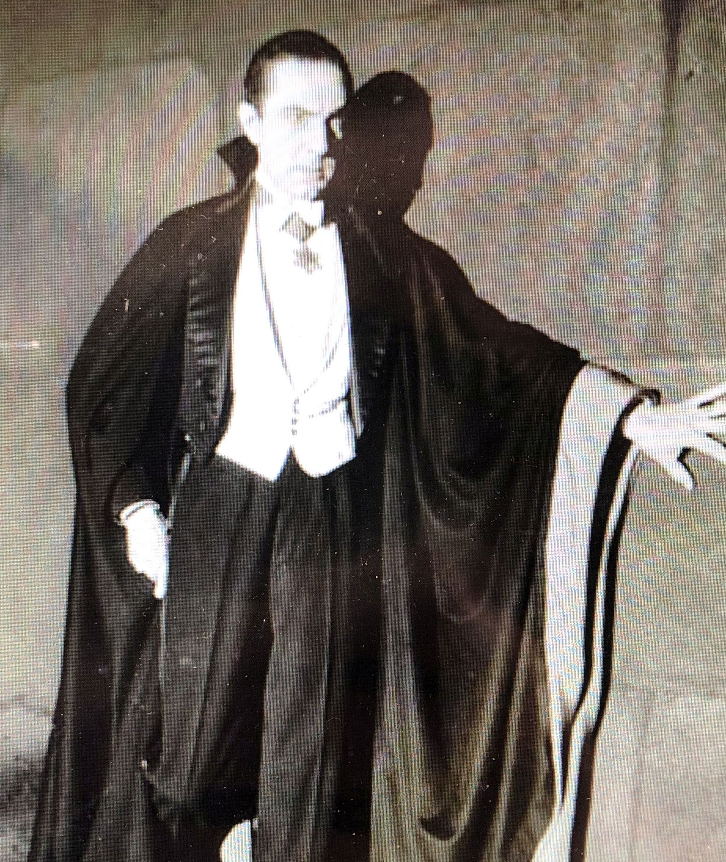
More aliasing

Slide 18
How to avoid aliasing
Low-pass filter (in hardware) prior to sampling (A to D conversion)
Action potentials have frequency content up to ~8 kHz. What frequency do we need to sample at?
Most of what is above 8 kHz is random thermal noise, so you aren’t so much aliasing a specific sine wave at a high frequency to one at a low frequency as you are adding broadband noise to your signal
A notable exception to this is periodic noise from switching mode power supplies (e.g. an iPhone charger), which sometimes switch at 10-30 kHz

Slide 19
Sampling: important points
Physiological signals only have frequency content in certain ranges
We should use low-pass filtering to remove everything above that range because it is noise
To prevent aliasing, we must sample at AT LEAST 2x higher frequency than the filter cutoff. In practice, use 3x.
We can use notch filtering to remove 60 Hz line noise and its harmonics, but that is problematic if our signal has power in those frequencies (e.g. local field potentials or EEGs)

Slide 20
Variable types and digital formats
What does your data look like once it’s inside the computer?
Good question.

Slide 21
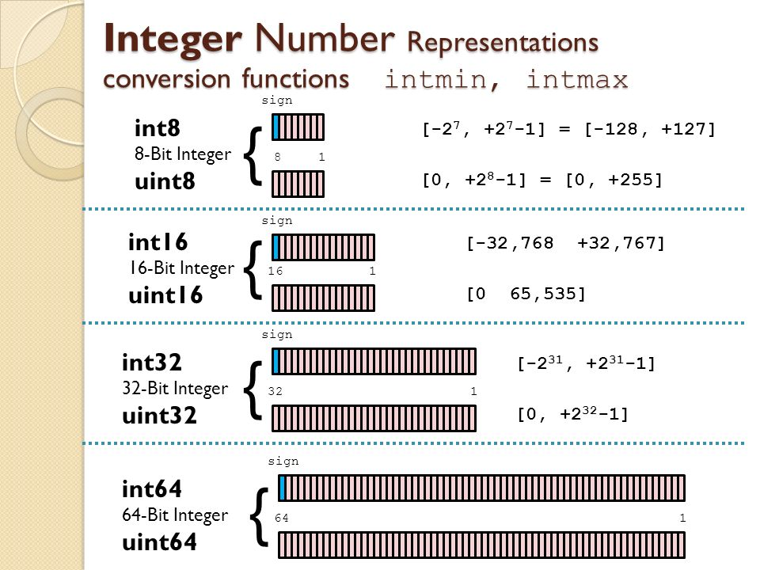

Slide 22
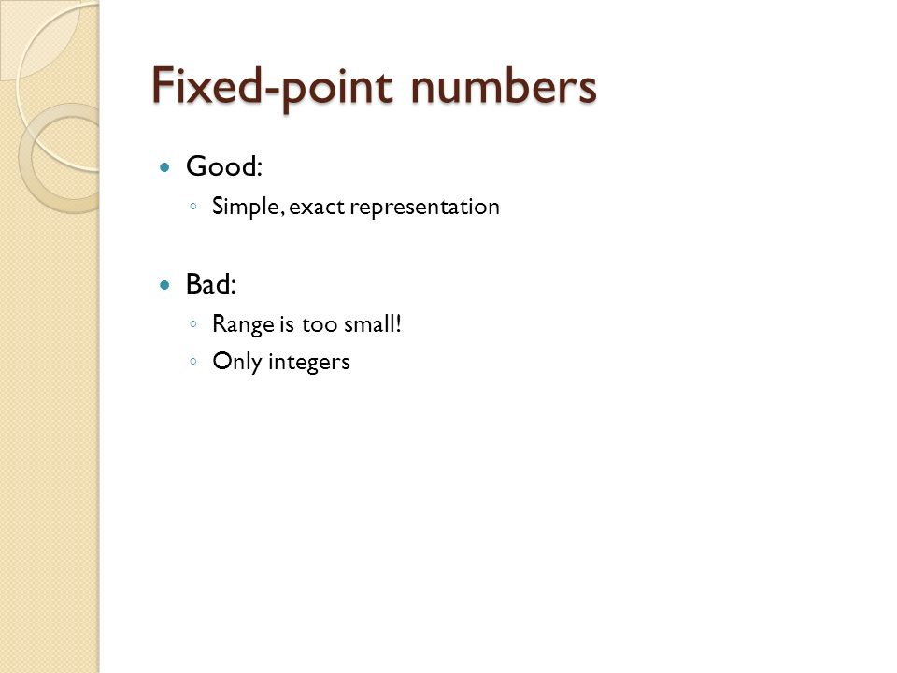

Slide 23
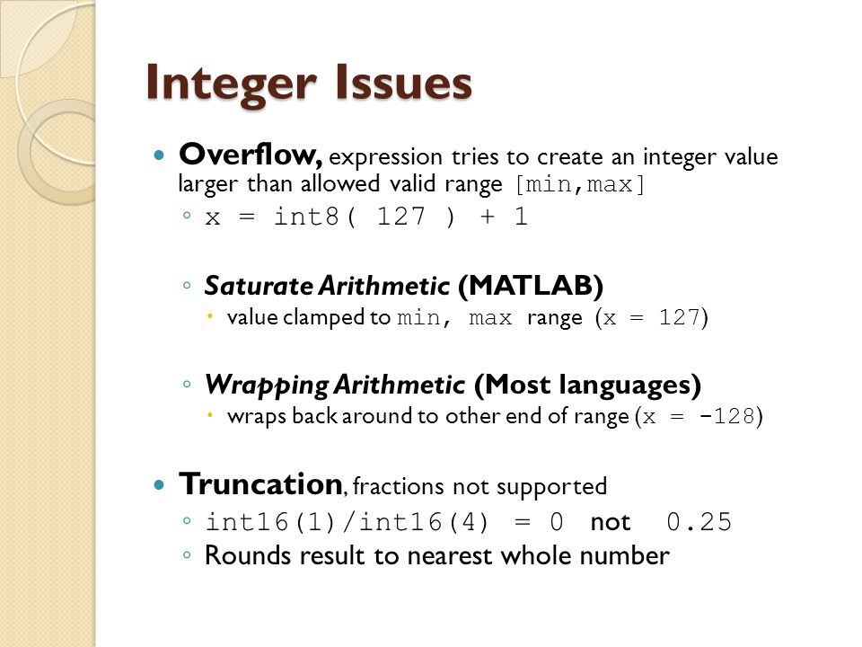
This is false – matlab will either convert it to Inf or implicitly convert it to type double

Slide 24
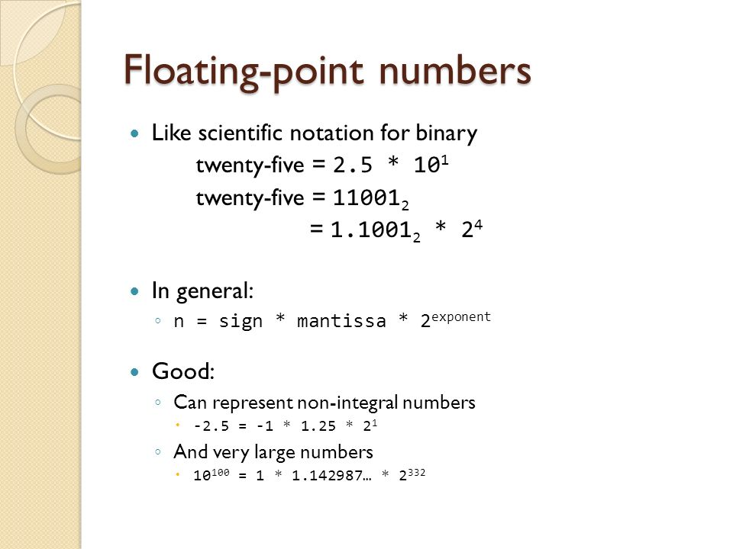
The data is typically acquired as ints. However, any math beyond addition and subtraction requires the data to be in a float format
CPUs do both integer and floating-point math.
GPUs are specialized to do only certain types of floating-point operations, and they do it much faster.

Slide 25
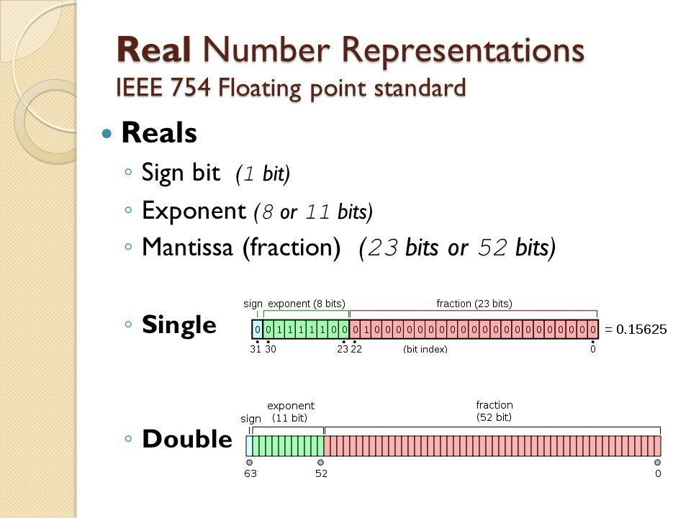
Pascal is the only language I’ve encountered that calls them reals instead of floats

Slide 26

However:

Slide 27
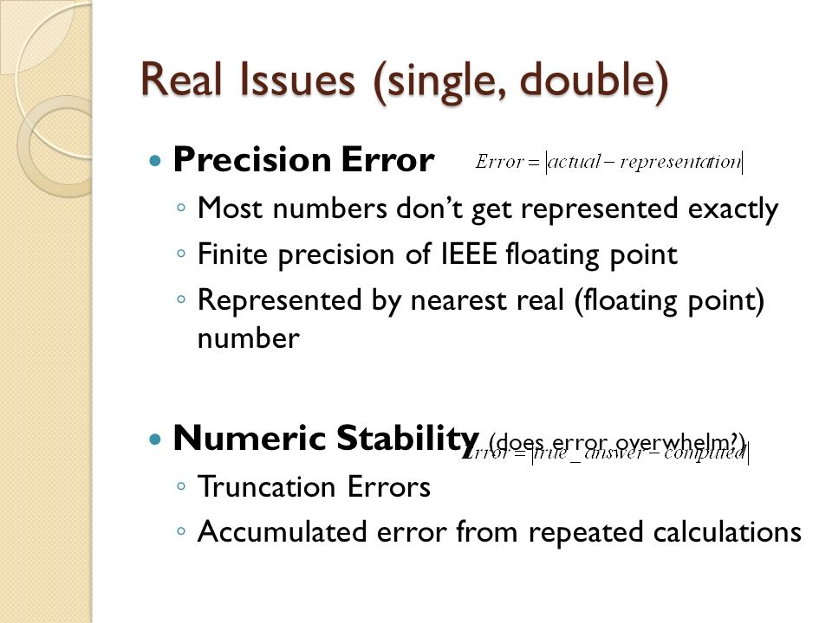
Float

Slide 28
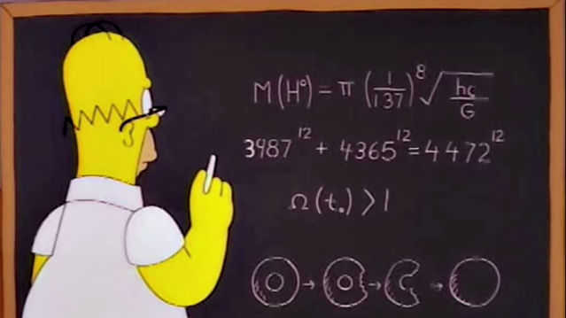
Numerical precision: a real-world example
Fermat’s Last Theorem: there are no positive integer solutions to X^{n} + Y^{n} = Z^{n} for n > 2
However:
There is a Simpsons episode where Homer discovers that a crayon he inserted in his nose as a child has migrated into his frontal lobe, suppressing his cognitive capacity. The doctor removes the crayon, and Homer’s true intellect is revealed.

Slide 29
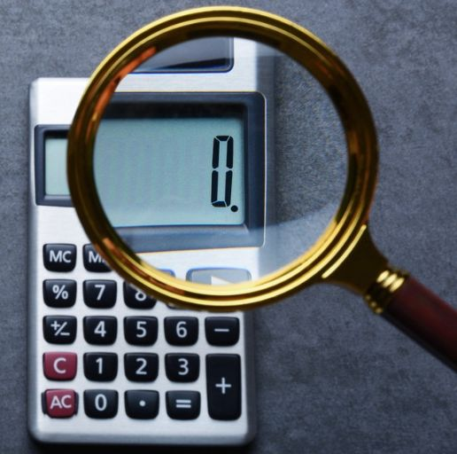
Did Homer Simpson disprove Fermat’s Last Theorem?
Does 3987^12 + 4365^12 = 4472^12 ???
On a scientific calculator, 3987^12 + 4365^12 – 4472^12 gives you an answer of…
Feeling alone in a world where no one understands his genius, Homer reinserts the crayon into his brain and returns to his normal life.
But what happens if we use double-precision floats?

Slide 30
Look at these matlab scripts
Just look at them.

Slide 31
But how much memory do these variable types take?
Good question.

Slide 32
How is memory/storage organized in a computer?
How big should I expect a data file to be?
How is the output of a 12-bit DAC stored?
How should I configure storage on computers in the lab?

Slide 33
Bonus 1: complex exponentials and further explanation of Fourier transforms

Slide 34
Bonus 2: linear vs. switching-mode power regulators

